Slide 1
Fiber bend loss & Dispersion
A.Sangeetha

Slide 2
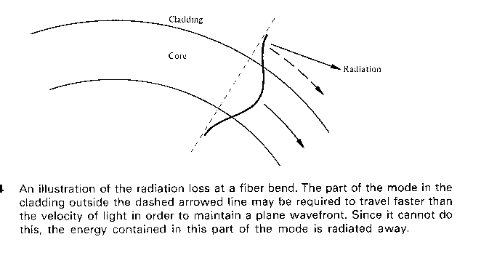
Bending loss

Slide 3




attenuation

Slide 4
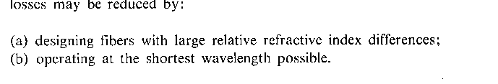
How to reduce loss?

Slide 5

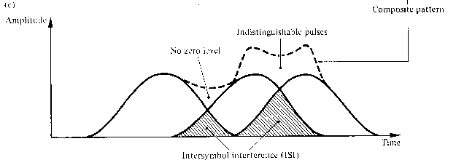
ISI
LIMITS MAX. POSSIBLE BANDWIDTH

Slide 6


BIT RATE

Slide 7
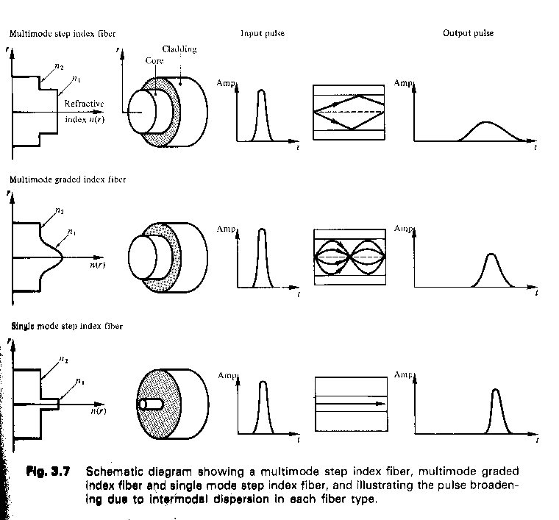

Slide 8





Slide 9

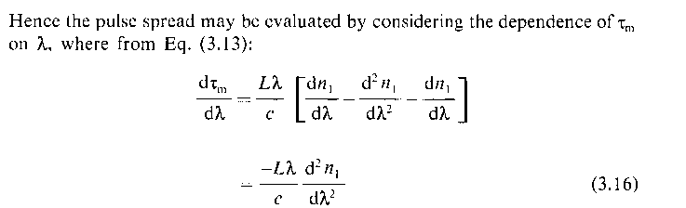
MATERIAL DISPERSION

Slide 10
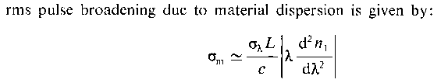
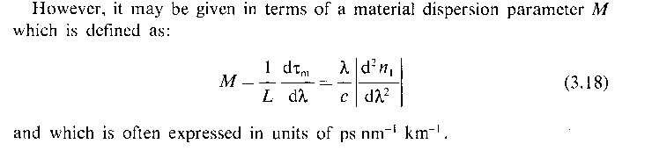

Slide 11
WAVEGUIDE DISPERSION

Slide 12
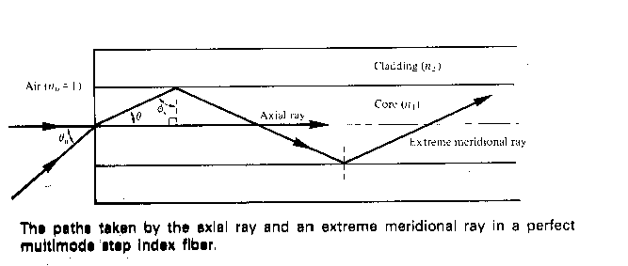
INTERMODAL DISPERSION

Slide 13



TIME DELAY

Slide 14

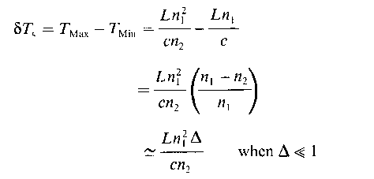
INTERMODAL DISPERSION

Slide 15



contd

Slide 16
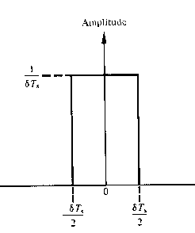





PERFECT STEP INDEX

Slide 17
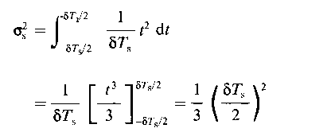

MULTIMODE STEP INDEX

Slide 18



Graded index fiber

